Slide 1


________________________________________________________________
Head Office : 11, rue de l'électricité . z i Ben Arous 2013 – Tunis – Tunisie
Tel : +216 71 384 451

Slide 2
ANATIM “AGENCE NORD-AFRICAINE DE TRANSPORT INTERNATIONAL ET DE MAGASINAGE“ was established in 1989 in Tunis, Tunisia. At the head the founder, Mr Ezzedine Abdeljelil, as chairman.
Over the years, ANATIM has expanded to not only include own offices and partners throughout Tunisia, but also tried to develop their partnership and collaborators in countries around the Maghreb, European countries and all over the world thanks to their licence as a member of WCA, WWCA and Ship to Me,,
ANATIM supplies added value to clients and Principals.
Aims to be the first choice as supplier of Logistics solutions.
With ANATIM, Key Success is Consultancy, Challenge and Difference

Slide 3




Slide 4

ANATIM, A logistics partner dedicated to deliver freight all over the world and able to give its customers the personal attention by giving them the means to get products to market faster and more efficiently.
Ocean Freight
Multimodal Transport
Road Freight
Consolidation & Lcl
Warehousing & Distribution
Supply Chain Solutions
Oil & Gas
Industry Sector - Automotive
Critical and pharmaceutical
Customs

Slide 5

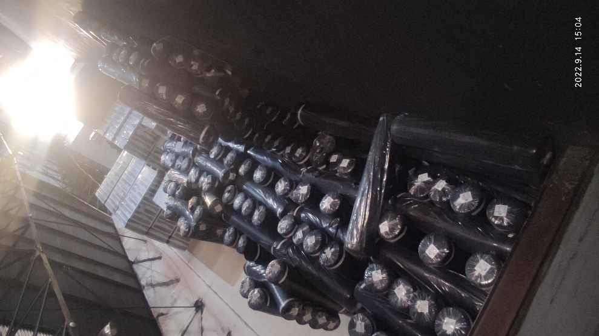

Slide 6
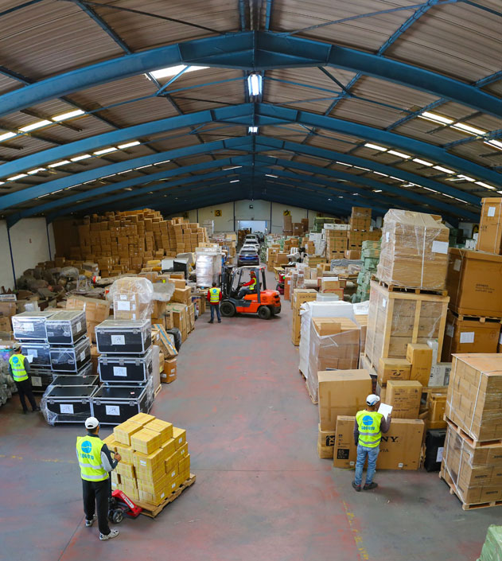
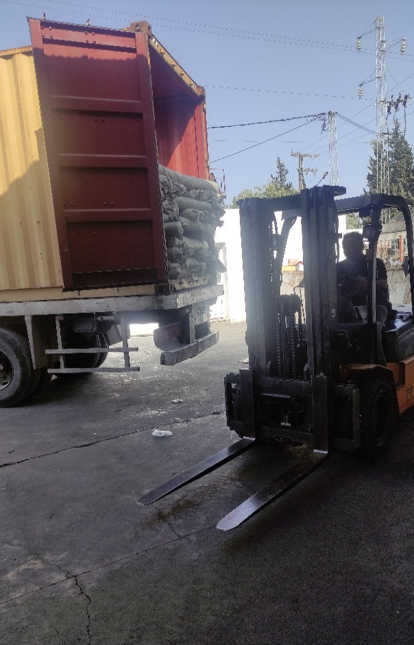
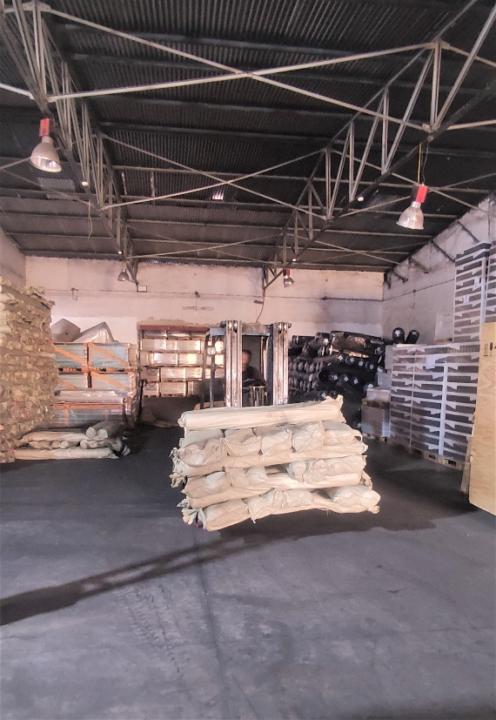
At ANATIM,we believe,key success is
“Consultancy, Challenge, Difference”

Slide 7

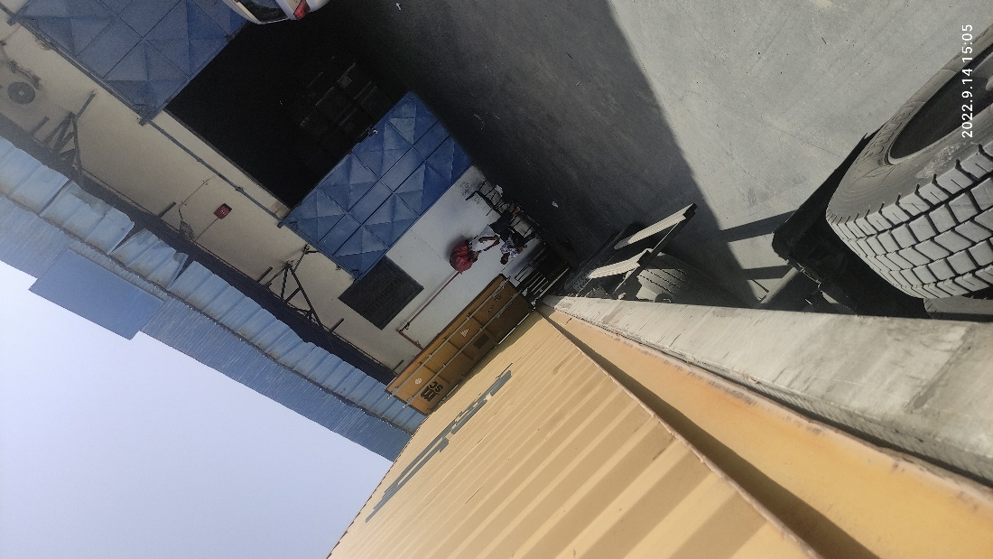
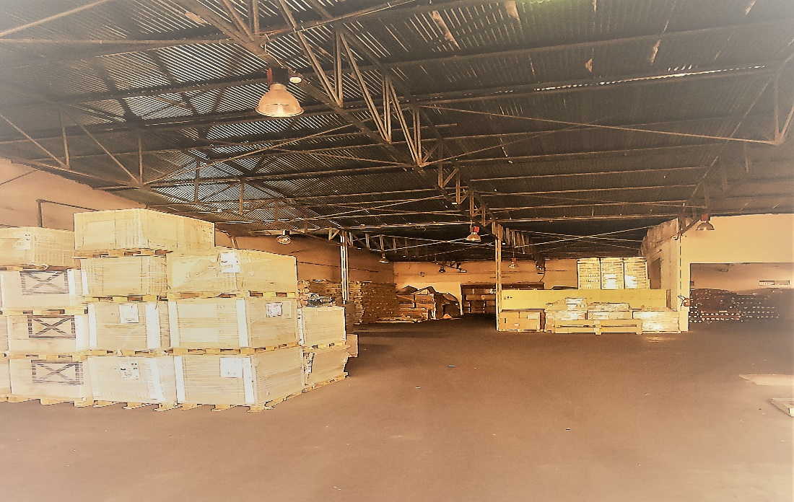

Slide 8

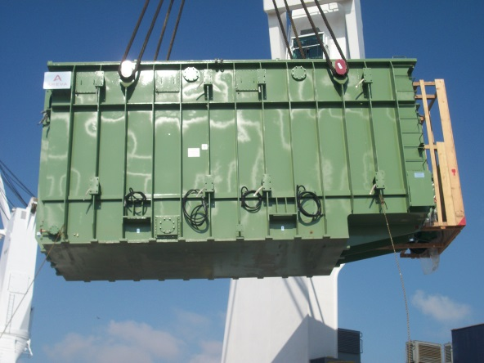
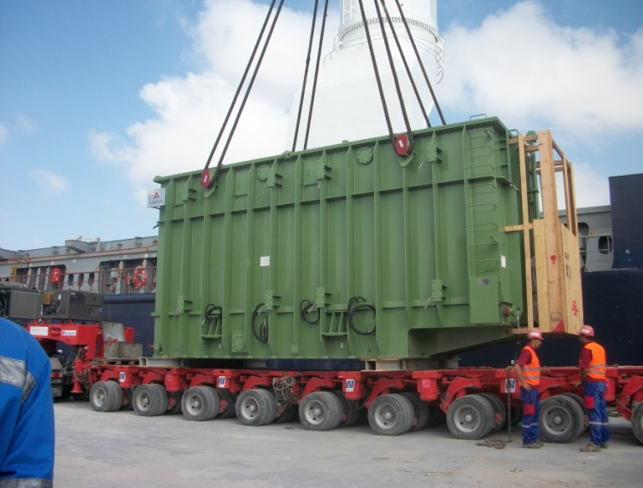
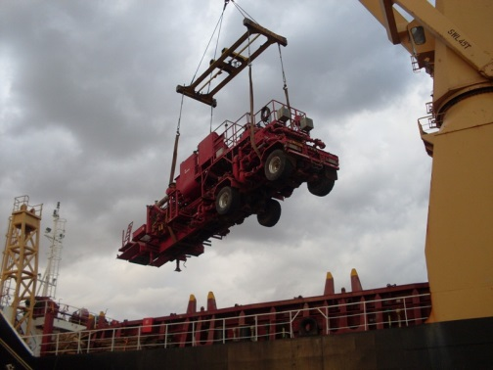
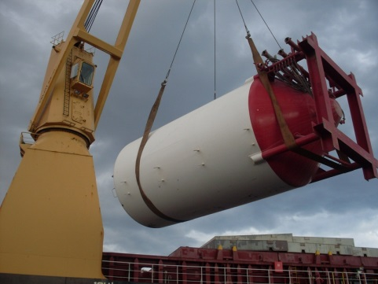
Photos descriptions
Photos description

Slide 9
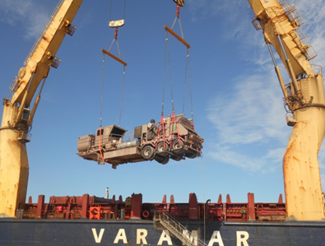
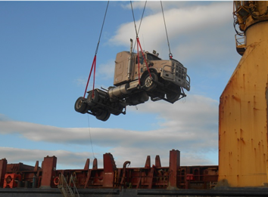
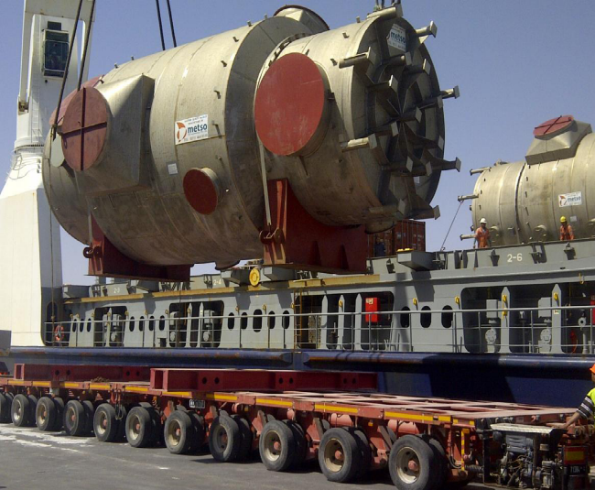


Slide 10
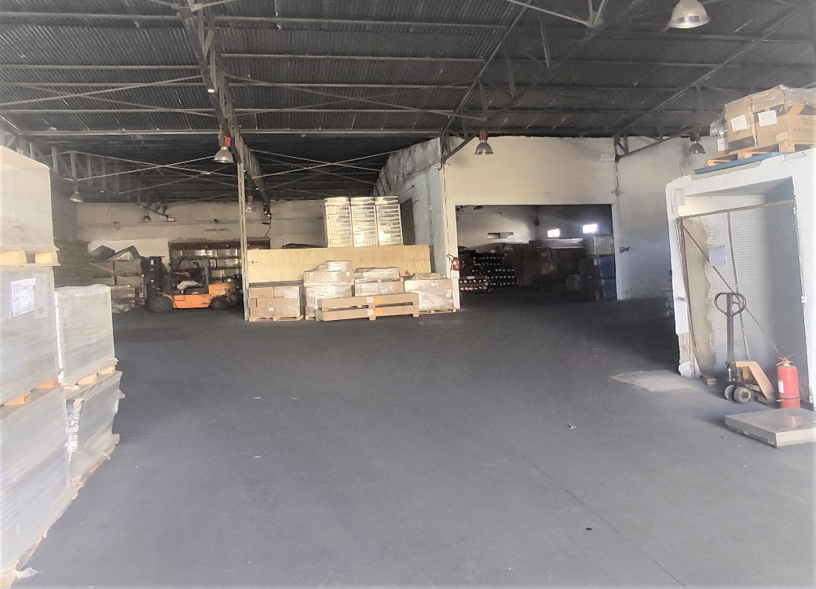
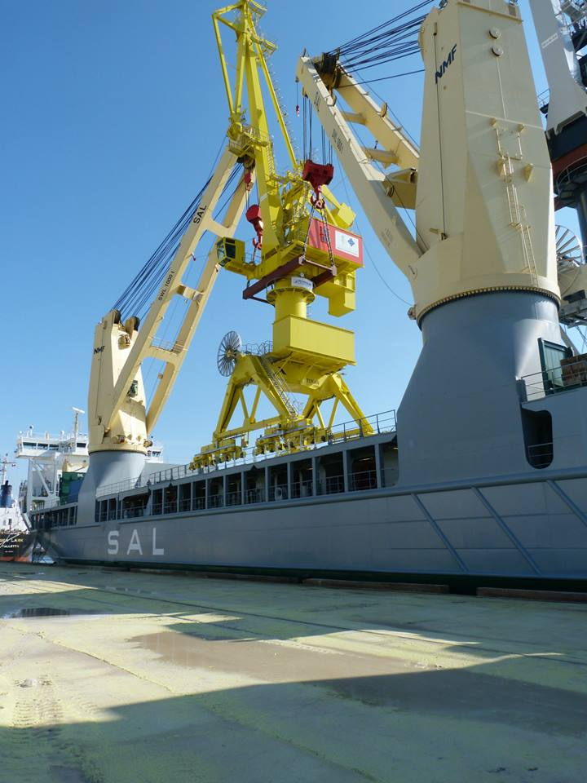
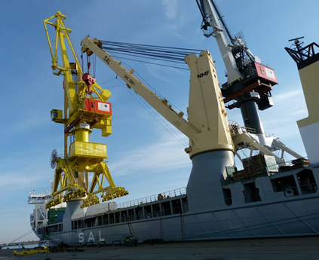
Notes …
Traffic description

Slide 11
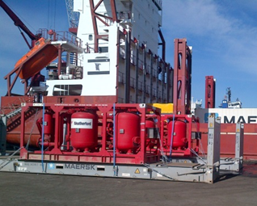
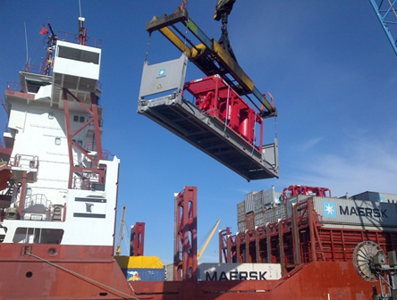


Slide 12
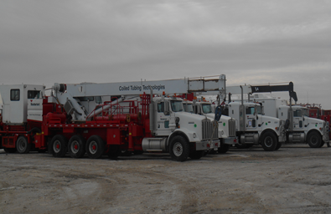
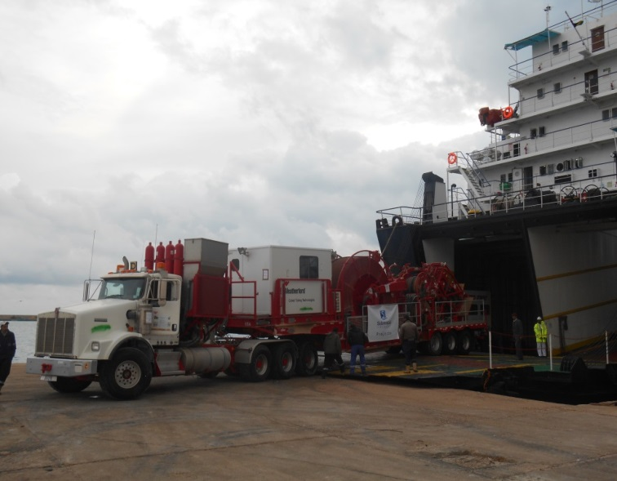
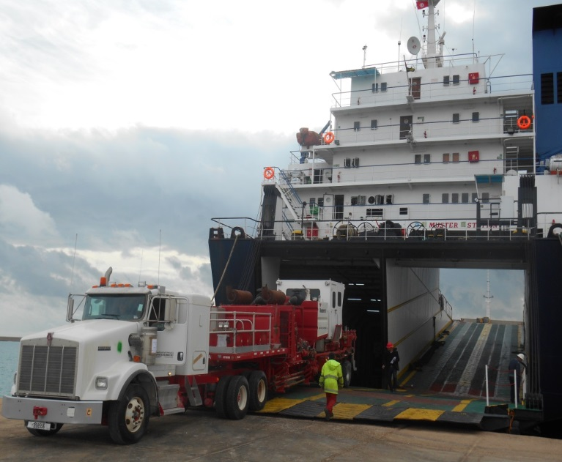
Description

Slide 13


ADD RESUME WORK

Slide 14
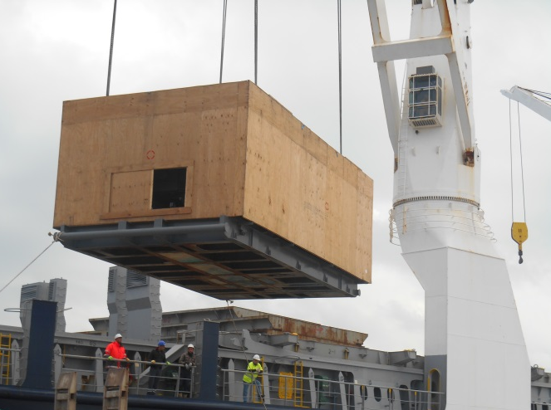
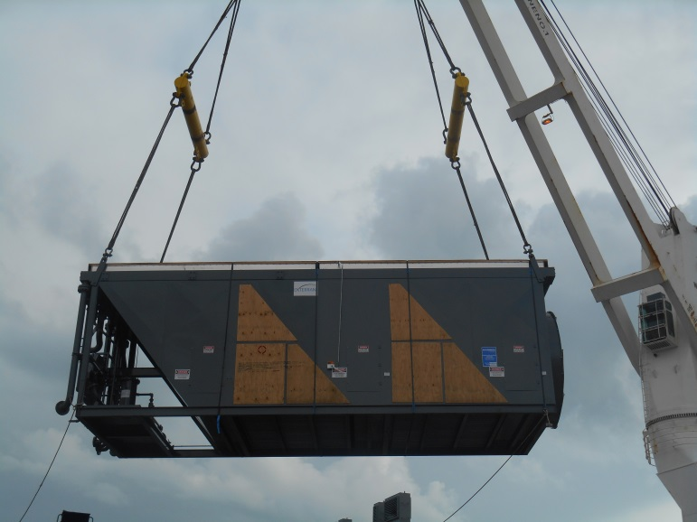
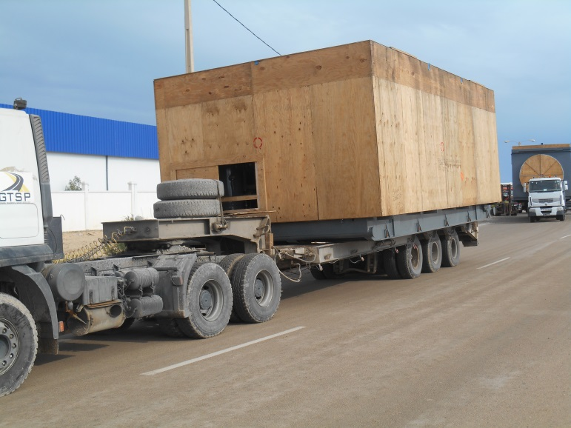
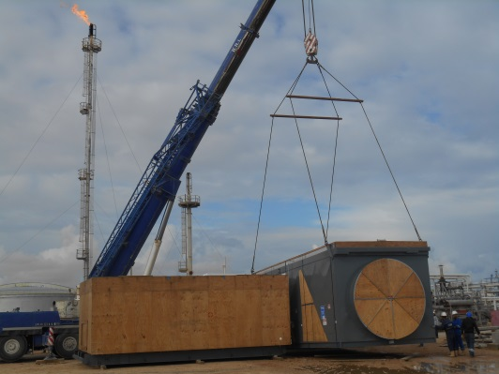
TO ADD DESCRIPTION

Slide 15

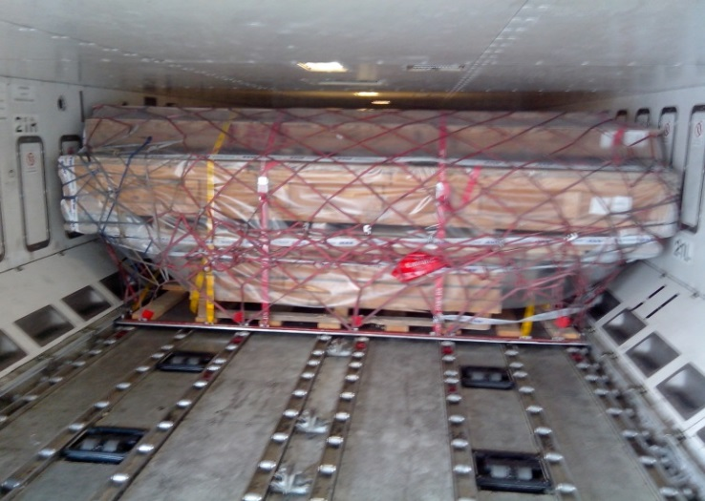
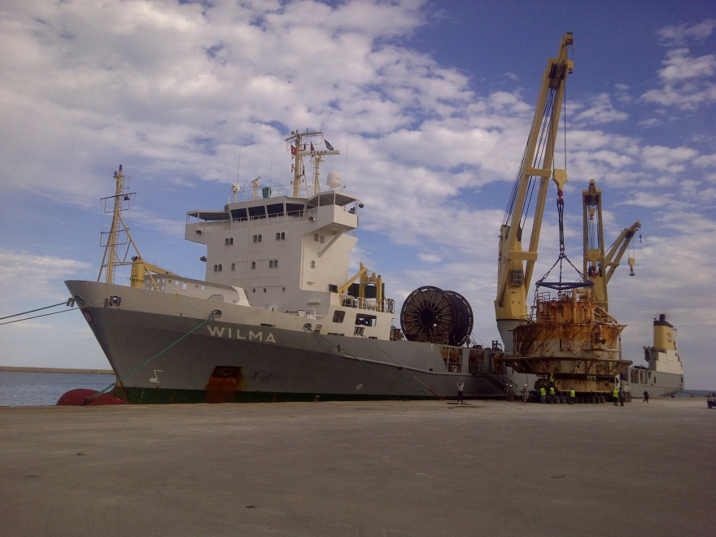
Heavy
PROJECT PRESENTATION

Slide 16

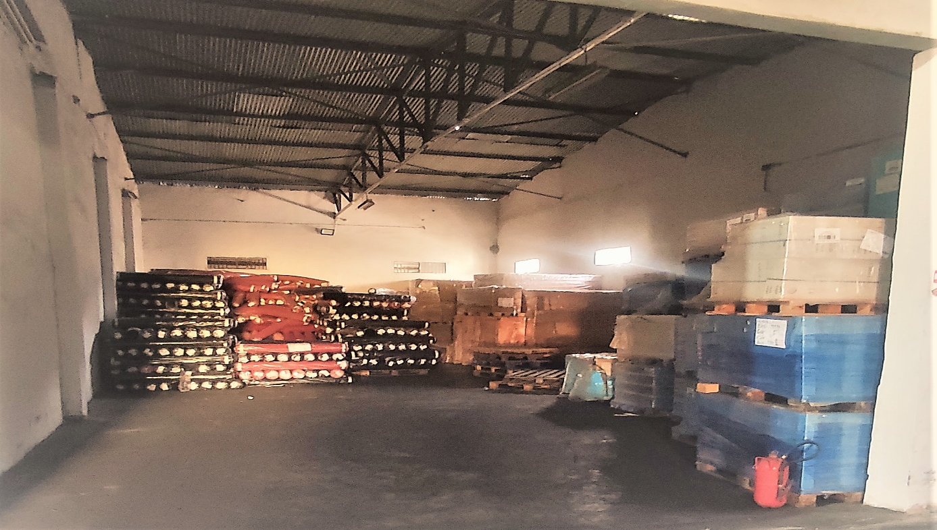
ANATIM

Slide 17
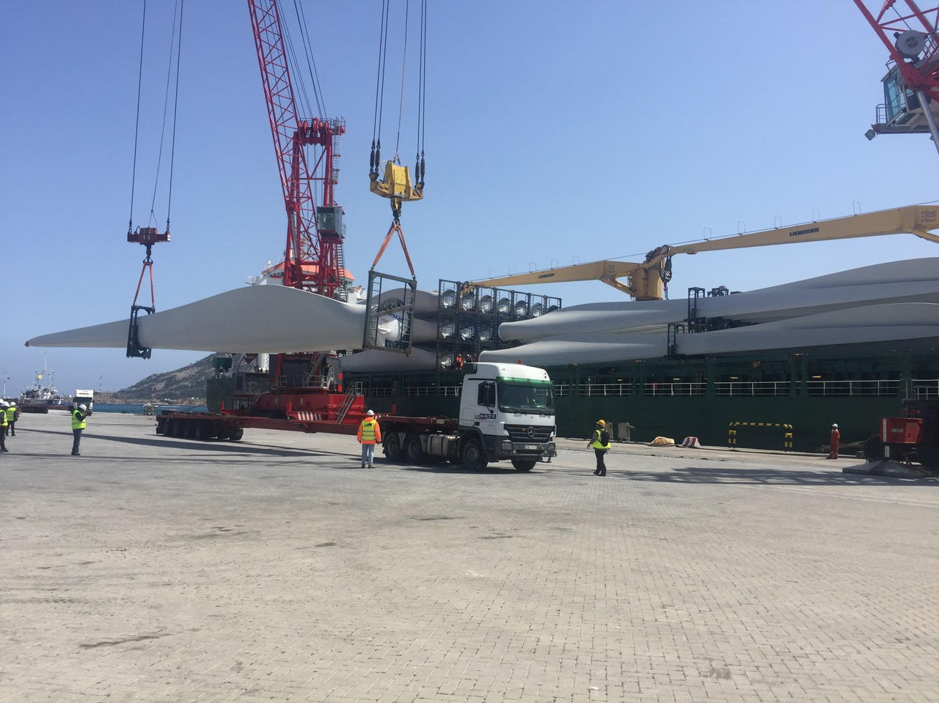
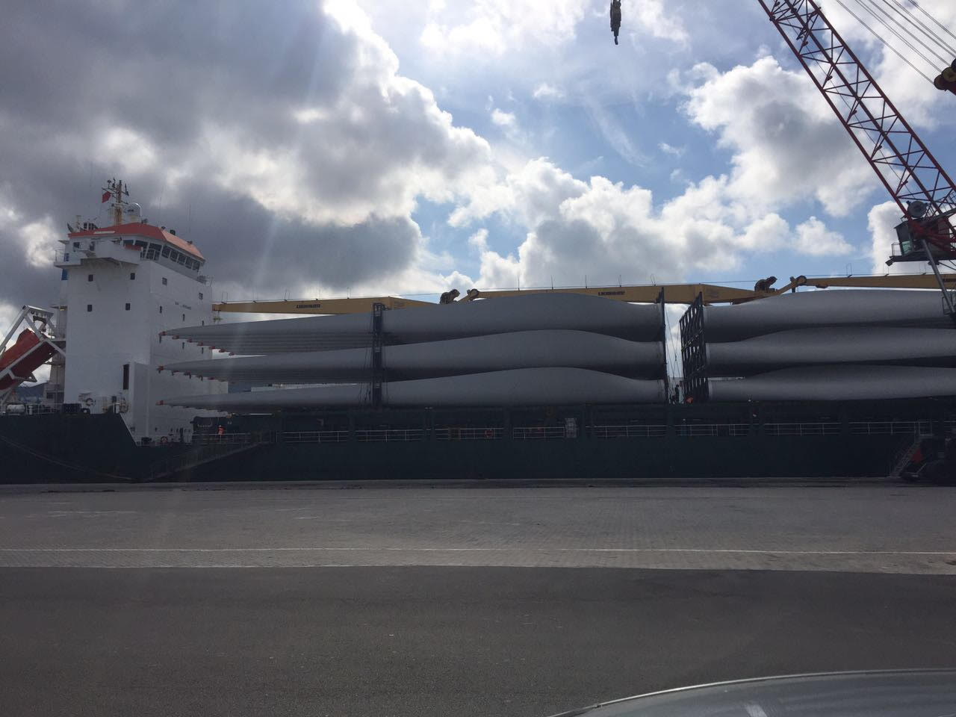
A N A T I M T U N I S I A

Slide 18

Thank you …

